Slide 1

ICT406 IT Professional Environment: Law, Ethics and Privacy Introduction
Lecturer: Dr. Farshid Keivanian
Course Coordinator: Dr. Abbass Ghanbary
a.ghanbary@aapoly.edu.au

Slide 2
Lecture Outline
What is IT Law?
Ethics in IT
Approach to Assessing Privacy Issues in a Mobile App
Moral Responsibility Five Rules
Privacy in Public – Surveillance
Privacy in Public – Collecting Information Without Permission
Privacy in Public – Database Searches for Individual Records
Assessment Methods (Direct from Unit Outline)
Tutorial Week 1 (Read Article and Answer Questions)
Group Class Presentation Activity

Slide 3
Course Objectives (Direct from Unit Outline)
Objectives
Introduction to ethics in the IT industry
Introduction to critical thinking techniques
Professionalism and professional ethics
Ethical theories and analysis
Privacy laws and regulations
Security and crime in cyberspace
Intellectual property and the law
Freedom of speech and Internet content regulation
Emerging technologies and ethical dilemmas
Information Technology and Society

Slide 4
What is IT Law?
Introductory Explanation: IT Law governs the use and regulation of technology, ensuring responsible and legal practices in digital interactions.
Practical Scenario: Imagine an Australian startup in Sydney that collects user data for personalized marketing. Discuss how IT Law could influence the way this company handles user data.

Slide 5
What is IT Law?
Class Discussion Question: How do you think IT Law helps protect individuals' data privacy in this scenario?
Responses:
IT Law sets guidelines for data handling to prevent misuse.
Companies must inform users about data collection and provide consent options.

Slide 6
What is IT Law?
Multiple-Choice Question:
Which of the following is a primary focus of IT Law?
A) Enhancing user interface designs
B) Ensuring data privacy and security
C) Maximizing online sales

Slide 7
Ethics in IT
Introductory Explanation: Ethics in IT relates to making morally responsible decisions about technology's impact on society.
Practical Scenario: A tech company in Melbourne has developed facial recognition software. Discuss ethical considerations the company must address.

Slide 8
Ethics in IT
Class Discussion Question: What ethical challenges do you think this company might face regarding user privacy?
Responses:
The company needs to consider if the technology might infringe on people's privacy.
They should ensure transparency and gain consent before using facial data.

Slide 9
Ethics in IT
Follow-Up Question: Can you think of an example where ethics influenced a technology decision?
One example is Apple's decision to prioritize user privacy by refusing to unlock a suspect’s iPhone for the FBI, highlighting their ethical stance on data security and user rights over external pressure.

Slide 10
Approach to Assessing Privacy Issues in a Mobile App
Introductory Explanation: This part covers applying IT Law and ethics in real-world technology contexts.
Practical Example: Imagine you are tasked with assessing a privacy issue in a Canberra-based mobile app. Outline how you would approach this.

Slide 11
Approach to Assessing Privacy Issues in a Mobile App
To assess a privacy issue in a Canberra-based mobile app, I would:
1. Identify Data Collection Practices: Review what data the app collects, such as personal information, location, or browsing habits.

Slide 12
Approach to Assessing Privacy Issues in a Mobile App
2. Evaluate User Consent: Check if the app clearly informs users about data collection and obtains informed consent, ensuring compliance with privacy regulations.

Slide 13
Approach to Assessing Privacy Issues in a Mobile App
3. Assess Compliance with Regulations: Verify the app’s adherence to relevant Australian privacy laws, such as the Privacy Act 1988, and any specific local Canberra regulations.

Slide 14
Approach to Assessing Privacy Issues in a Mobile App
4. Analyze Data Security Measures: Examine how securely the app stores, processes, and transmits user data to prevent unauthorized access.

Slide 15
Approach to Assessing Privacy Issues in a Mobile App
5. Report Findings and Recommendations: Summarize findings and suggest improvements to enhance user privacy and align with ethical standards.

Slide 16
Approach to Assessing Privacy Issues in a Mobile App
Class Discussion Question: How would you approach evaluating a technology's compliance with ethical standards?

Slide 17
Approach to Assessing Privacy Issues in a Mobile App
To evaluate a technology's compliance with ethical standards, consider:
Identify Ethical Guidelines: Review relevant ethical frameworks, industry standards, and organizational policies.
Assess Transparency: Determine if the technology provides clear information about its data practices, user rights, and limitations.

Slide 18
Approach to Assessing Privacy Issues in a Mobile App
Evaluate Data Usage and Privacy: Examine how the technology collects, stores, and shares data to ensure it respects user privacy.
Check Fairness and Inclusivity: Ensure the technology does not discriminate and is accessible to diverse users.

Slide 19
Approach to Assessing Privacy Issues in a Mobile App
5. Analyze Impact: Consider potential positive and negative societal impacts, aiming to minimize harm.

Slide 20
Approach to Assessing Privacy Issues in a Mobile App
Multiple-Choice Question:
What is a key component of ethical IT assessments?
A) Evaluating software efficiency
B) Assessing privacy protection measures
C) Reducing operational costs

Slide 21
Moral Responsibility Five Rules
We will introduce the Moral Responsibility in IT, with a practical scenario, discussion, and follow-up questions.

Slide 22
Moral Responsibility Five Rules
Moral Responsibility Rule 1
Introductory Explanation: The creators of any computing artifact are responsible for its impact on users and society.
Practical Scenario: Suppose a software development company in Sydney creates an AI-based facial recognition app. Discuss who should be responsible if the app is later found to misidentify people, causing harm.

Slide 23
Moral Responsibility Five Rules
Class Discussion Question: Who do you think should take responsibility for the misidentification issues in this case?
The developers who designed the recognition algorithms.
Managers who approved the deployment without sufficient testing.

Slide 24
Moral Responsibility Five Rules
Moral Responsibility Rule 2
Introductory Explanation: Responsibility is shared and not diminished just because many people are involved in a project.
Practical Scenario: Imagine a Melbourne-based team develops a self-driving car system. Although multiple teams contributed, accidents are occurring. Discuss who should be responsible.

Slide 25
Moral Responsibility Five Rules
Class Discussion Question: In this case, does responsibility lie with one team, or is it shared among all?
Responsibility is shared, as every team member contributed to the system.
Each person is accountable for their part, even if others are involved.

Slide 26
Moral Responsibility Five Rules
Moral Responsibility Rule 3
Introductory Explanation: People who use a computing artifact are responsible for how they use it.
Practical Scenario: A Brisbane marketing agency uses data analytics software to track user behavior. What responsibilities do users (the agency team) have in ensuring ethical data use?

Slide 27
Moral Responsibility Five Rules
Class Discussion Question: What do you think is the ethical responsibility of those using this data?
They should use the data only as intended, respecting user privacy.
They need to follow all legal and ethical guidelines for data use.

Slide 28
Moral Responsibility Five Rules
Moral Responsibility Rule 4
Introductory Explanation: Developers and users must consider the larger social systems when creating and using technology.
Practical Scenario: In Canberra, a startup is launching a social media platform that encourages public discourse. Discuss how the platform might impact the community.

Slide 29
Moral Responsibility Five Rules
Why is it important to consider how a social media platform might affect users and society?
It could influence public opinion and behavior, so responsibility is crucial.
It must promote a safe and respectful environment for all users.

Slide 30
Moral Responsibility Five Rules
Moral Responsibility Rule 5
Introductory Explanation: Creators must be transparent about a computing artifact’s effects and avoid misleading users.
Practical Scenario: A tech firm in Sydney launches an AI assistant but fails to disclose all its data collection practices. Who bears responsibility if users feel deceived?

Slide 31
Moral Responsibility Five Rules
What is the main focus of moral responsibility in IT?
A) Increasing user engagement
B) Ensuring safe, ethical use of technology
C) Reducing development time

Slide 32
Privacy in Public – Surveillance
Introductory Explanation: Surveillance in public spaces often involves tracking individuals through cameras, phones, or other devices, raising concerns about privacy and consent.

Slide 33
Privacy in Public – Surveillance
Practical Scenario: Imagine the city of Melbourne installs CCTV cameras in public parks to enhance safety. However, some citizens worry about being constantly watched.
Class Discussion Question: What are the benefits and concerns of using surveillance in public spaces like parks?

Slide 34
Privacy in Public – Surveillance
Responses:
Increases safety and helps prevent crime.
Raises privacy concerns as people feel they are constantly monitored.

Slide 35
Privacy in Public – Collecting Information Without Permission
Introductory Explanation: In some cases, organizations collect personal data without directly asking for user consent, which can lead to issues of trust and legality.
Practical Scenario: A Sydney-based company uses Wi-Fi tracking in shopping centers to analyze foot traffic patterns. Many shoppers don’t know their location data is being recorded.

Slide 36
Privacy in Public – Collecting Information Without Permission
Class Discussion Question: How do you think people might feel if they learned their data was collected without their permission?
Responses:
They might feel uncomfortable and distrustful of the company.
They could question if their data is safe or being misused.

Slide 37
Privacy in Public – Database Searches for Individual Records
Introductory Explanation: Databases allow quick access to individual records, but searching personal data without a valid reason can be an invasion of privacy.

Slide 38
Privacy in Public – Database Searches for Individual Records
Practical Scenario: The police in Canberra access a large database to locate individuals in emergencies. However, there’s a risk of misuse if officers access records without proper authorization.

Slide 39
Privacy in Public – Database Searches for Individual Records
Class Discussion Question: When might it be appropriate to search a database for individual records, and when might it be an invasion of privacy?
It’s appropriate in emergencies or with a legal warrant.
Inappropriate if used for personal curiosity or without legitimate reason.

Slide 40
Privacy in Public – Database Searches for Individual Records
What is a primary concern when collecting public data without permission?
A) Improving public relations
B) Increasing data analysis capabilities
C) Maintaining individual privacy

Slide 41
Assessment Methods (Direct from Unit Outline)
Assessment tasks | Wight
1. Early intervention – Online Quiz test comprising of a variety of theoretical questions (MCQs and True/False). | 10%
2. Mid-term test comprising of a variety of theory and calculation questions (Short Answer questions). | 30%
3. ERD modelling and Querying task. 1,000 Words equivalent. | 20%
4. Database design based on a given scenario and report task. 2,000 Words equivalent. | 40%

Slide 42
Assessment Methods (Direct from Unit Outline)
1. Early Intervention (10%)
Task: Online Quiz Test
Description: Comprises a variety of theoretical questions including Multiple Choice Questions (MCQs) and True/False questions.
Purpose: To assess the initial understanding of key concepts early in the course.

Slide 43
Assessment Methods (Direct from Unit Outline)
2. Mid-Term Test (30%)
Task: Theory and Calculation Questions
Description: Includes a variety of theory and calculation questions (Short Answer questions).
Purpose: To evaluate the comprehension and application of theoretical knowledge and problem-solving skills mid-way through the course.

Slide 44
Assessment Methods (Direct from Unit Outline)
3. Individual Report (20%)
Task: Report on Ethical Theories and IT Contexts
Description: A written report of 1,000 words.
Purpose: To develop and demonstrate the ability to critically analyze and articulate ethical theories in the context of IT.

Slide 45
Assessment Methods (Direct from Unit Outline)
4. Final Report (40%)
Task: Report on a Given Ethical Dilemma Case Study
Description: A detailed report of 2,000 words.
Purpose: To synthesize knowledge from the course and apply it to a complex ethical dilemma, demonstrating a deep understanding and ability to propose solutions.
Each task is designed to progressively build and assess the student's understanding and application of ethical principles in IT contexts, culminating in a comprehensive case study analysis.

Slide 46
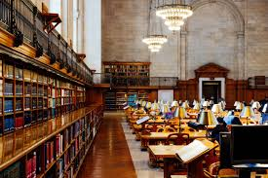
Reading Materials

Slide 47
Books
Gordon, D., Stavrakakis, I., Gibson, J. P., Tierney, B., Becevel, A., Curley, A., ... & O’sullivan, D. (2021). Perspectives on computing ethics: a multi-stakeholder analysis. Journal of Information, Communication and Ethics in Society. Course Accreditation (Existing Provider) (v 2.1) Page 6 of 6
Gunkel, D. J. (2018). The other question: can and should robots have rights?. Ethics and Information Technology, 20(2), 87-99. Kaminski, M. (2020). A recent renaissance in privacy law. Communications of the ACM, 63(9), 24-27.
Niederman, F., & Baker, E. W. (2021, September). Ethics and AI Issues: Old Container with New Wine?. In Conference on e-Business, e-Services and e-Society (pp. 161-172). Springer, Cham.
Winfield, A. F., Michael, K., Pitt, J., & Evers, V. (2019). Machine ethics: the design and governance of ethical AI and autonomous systems [scanning the issue]. Proceedings of the IEEE, 107(3), 509-517

Slide 48
Videos
https://www.youtube.com/watch?v=u399XmkjeXo
https://www.youtube.com/watch?v=Xki2fRA0bY8
https://www.youtube.com/watch?v=0WxOGR6HKFs
https://www.youtube.com/watch?v=MQc-UjE560A

Slide 49
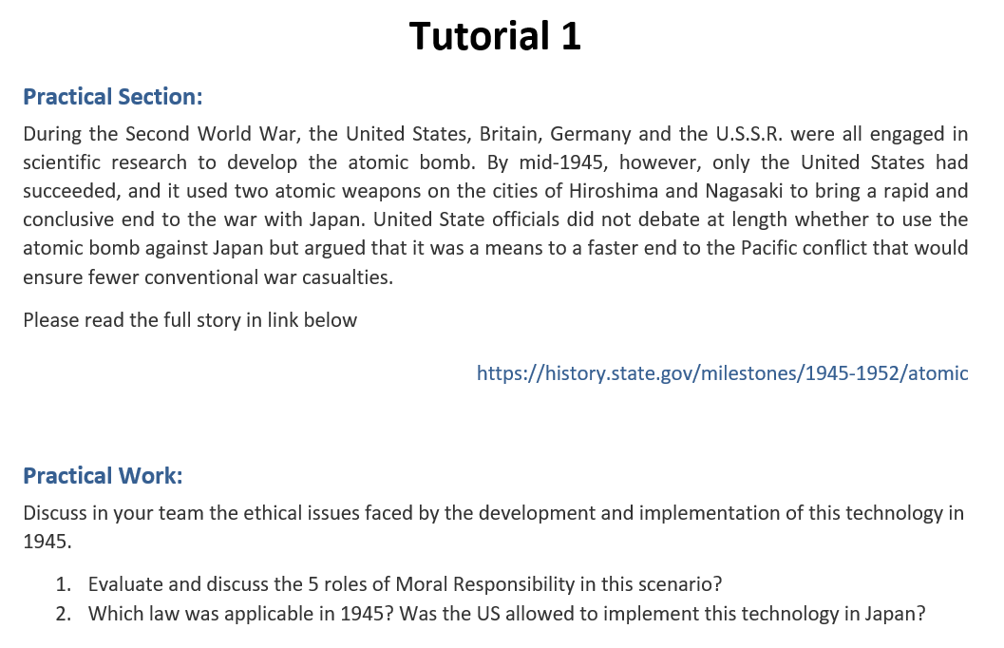
Tutorial Week 1 (Read Article and Answer Questions)

Slide 50
1. Evaluate and discuss the 5 roles of Moral Responsibility in this scenario?
WWII Atomic Bomb Ethical Discussion
Evaluate and discuss the 5 roles of Moral Responsibility in this scenario:
Role 1: Design and Development Responsibility
Discuss the moral implications of scientists and engineers developing the atomic bomb, considering the potential for mass destruction.
Role 2: Decision to Use the Bomb
Analyze the responsibility of U.S. officials in deciding to use the bomb on Hiroshima and Nagasaki.
Role 3: Implementation and Execution
Evaluate the ethical considerations of the military personnel who carried out the bombings.
Role 4: Post-Deployment Consequences
Consider the long-term responsibilities related to the aftermath of the bombings, including radiation effects and rebuilding efforts.
Role 5: Global Diplomatic Impact
Reflect on the moral responsibility of using atomic diplomacy to influence global politics and the ethical ramifications of such actions.

Slide 51
2. Which law was applicable in 1945? Was the US allowed to implement this technology in Japan?
2. Applicable Law in 1945:
Legal Context:
Examine the international laws in place in 1945 and whether the U.S. was legally permitted to use atomic weapons against Japan.
Ethical vs. Legal:
Discuss the distinction between what was legally permissible and what was ethically justifiable in the context of the atomic bombings.

Slide 52
Group Class Presentation Activity
Title: Research and Present on Surveillance and Privacy in Different Sectors
Objective: Explore and understand the use of surveillance and privacy practices across different sectors by examining real-world examples and evaluating ethical implications.

Slide 53
Group Class Presentation Activity
Instructions:
Group Assignment: Form groups of 3-4 members. Each group will research one of the following sectors:
Healthcare
Retail
Education
Government
Financial Services

Slide 54
Group Class Presentation Activity
2. Research Focus:
Identify a real-world example of surveillance or data collection used within your assigned sector.
Describe the technology and how it’s used. For example, CCTV in schools for safety or customer data tracking in retail for personalized marketing.
Evaluate the ethical implications, considering privacy concerns, consent, and public trust.

Slide 55
Group Class Presentation Activity
3. Presentation Structure:
Introduction: Briefly introduce the sector and the example you researched.
Technology Explanation: Describe the surveillance or data collection technology used in this example.
Ethical Analysis: Discuss the ethical considerations, including benefits, privacy issues, and public perception.
Recommendations: Suggest ways to balance the benefits of surveillance with ethical concerns. For example, how can the organization improve transparency or ensure data privacy?

Slide 56
Group Class Presentation Activity
4. Discussion Questions:
After each presentation, ask the class:
Would you feel comfortable with this type of surveillance or data collection? Why or why not?
What other ethical issues could arise in this sector related to surveillance?

Slide 57
Group Class Presentation Activity
5. Deliverable:
Each group will present for 5-7 minutes.
Include at least one real-world example, an ethical analysis, and your group’s recommendations.

Slide 58
Group Class Presentation Activity
Depth of Research: Thorough understanding and detail in describing the technology and ethical issues.
Clarity of Presentation: Clear structure and explanation of concepts.
Ethical Analysis: Thoughtfulness in discussing ethical implications and providing recommendations.
Engagement: Ability to engage classmates with questions and discussions.

Slide 59
Group Class Presentation Activity
This activity encourages you to apply the concepts of surveillance and ethics in IT, fostering critical thinking and teamwork.

Slide 60

Happy A Learning Day!
Thank You!
Dr. Farshid Keivanian

